Slide 1
Introduction to Fuzzy Logic, Fuzzy Sets & Fuzzy Set Operations

Slide 2
pip install scikit-fuzzy

Slide 3
Topics to be Covered
What is a FUZZY LOGIC?
Binary/Traditional Logic vs. Fuzzy Logic
Membership Function
Crisp Set vs. Fuzzy Set
Fuzzy Set Representation

Slide 4
What is a FUZZY LOGIC?
Fuzzy Logic is an approach to computing based on “degrees of truth” rather than the usual “true or false” (1 or 0) Boolean logic on which the modern computer is based.
https://www.youtube.com/watch?v=YQY8yGl7xBM&index=3&list=PLIY8eNdw5tW9ZqgI9nfXxr6r-FHnLS90k

Slide 5
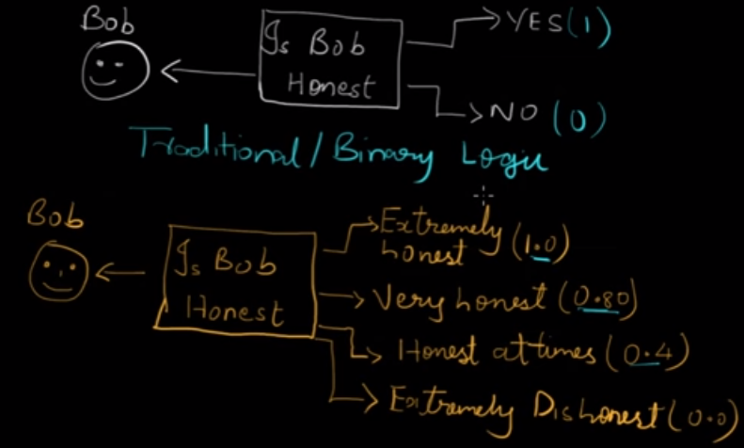
Binary/Traditional Logic vs. Fuzzy Logic
Applications
Weather Forecasting
Business Decision Making
AI & Neural Network
Soft Computing
Electronics & Telecommunications
Robotics
Degree of truth
Membership Function

Slide 6
Crisp Set vs. Fuzzy Set
Crisp Set → Classical sets which have distinct objects. For e.g.,
A = {apples, oranges,mangoes}
B = {2, 4, 6, 8}
(each element is called an entity / member)
Fuzzy Set → Based on the degree of membership concept.
A = { 0.4 + 0.6 + 0.7 }
train
car
cycle
train has a degree of membership of 0.4 associated with fuzzy set A.
0.4 → membership degree
If the degree of membership is 0, it means that the element is not associated (or, least associated) with set A.
If the degree of membership is 1, it means that the element is strongly associated with set A.
Notes:
Fuzzy Logic is so important in real world scenario because most of the scenarios do not have distinct values, but are based on approximation. For e.g., the no. of RBC in your blood cannot be actually counted, but we can always have an estimated value. Or, the growth of bacteria in a particular environment can only be predicted but we cannot have the correct value.
Fuzzy logic operates on the concept of membership and the degrees of membership, which ranges from 0 to 1.

Slide 7
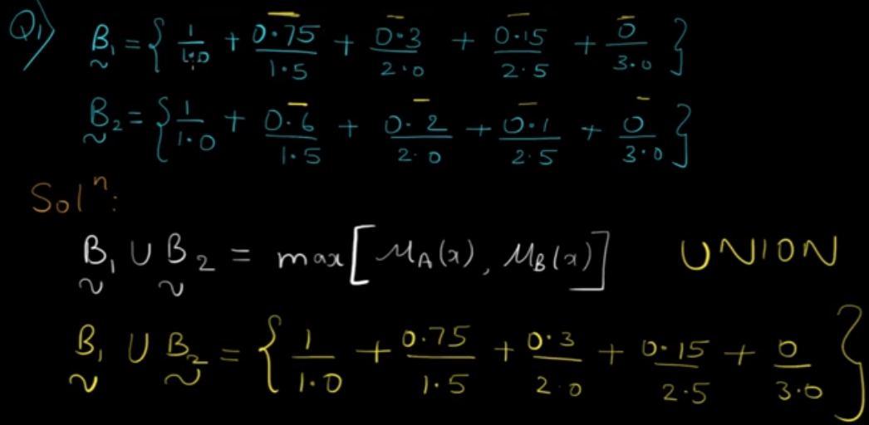
Union, Intersection, Complement, Difference

Slide 8
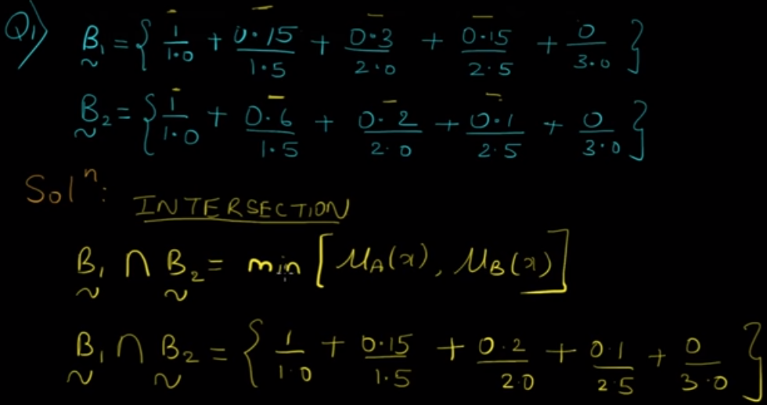
Union, Intersection, Complement, Difference

Slide 9
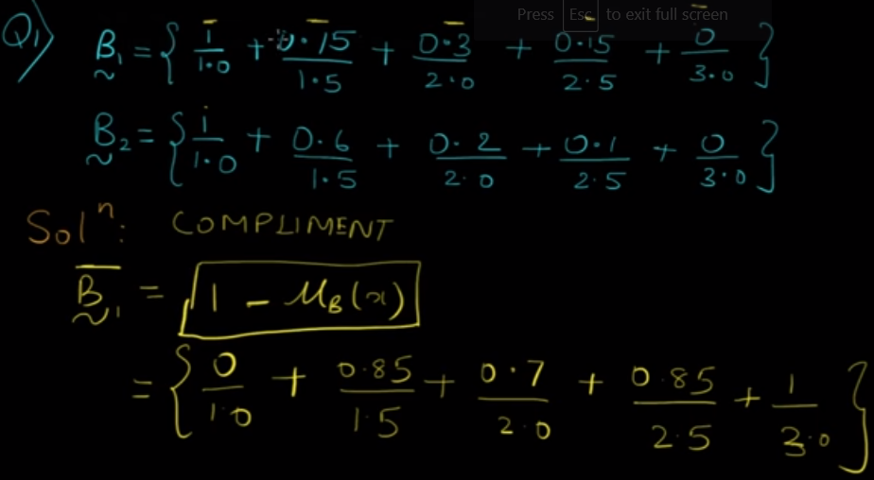
Union, Intersection, Complement, Difference

Slide 10
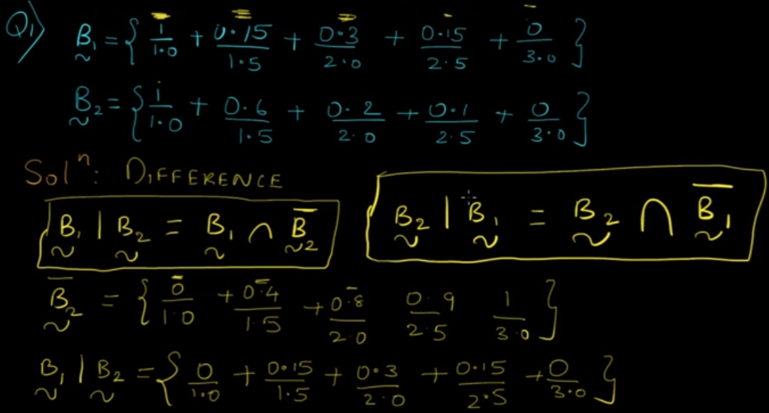
Union, Intersection, Complement, Difference

Slide 11
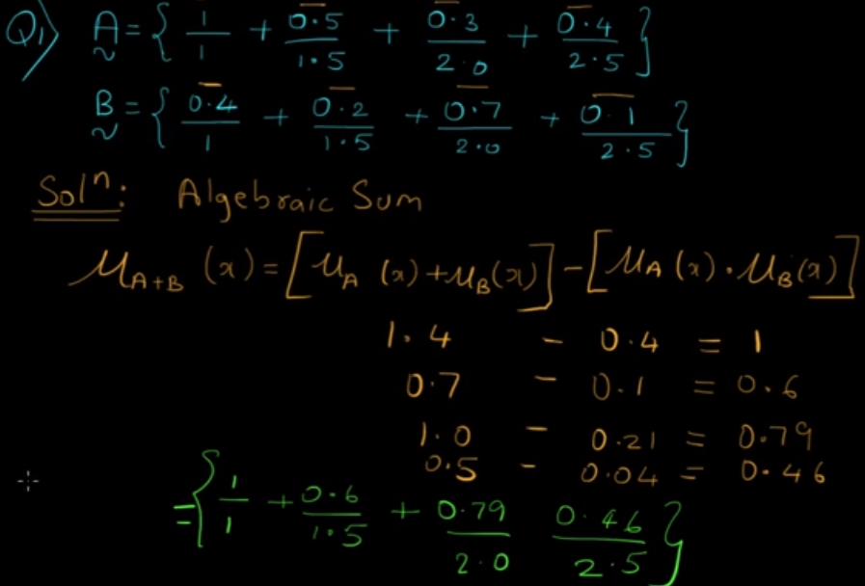
Algebraic Sum, Algebraic product, Bounded Sum, Bounded Difference

Slide 12
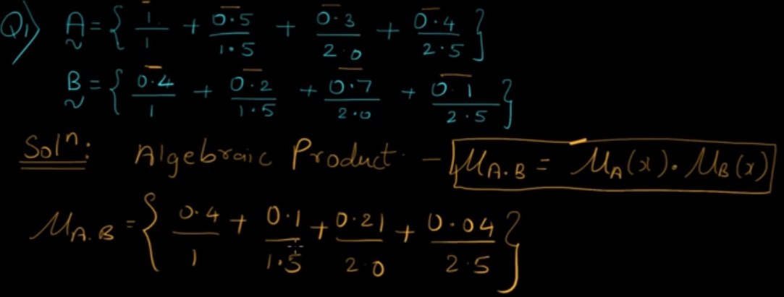

Slide 13
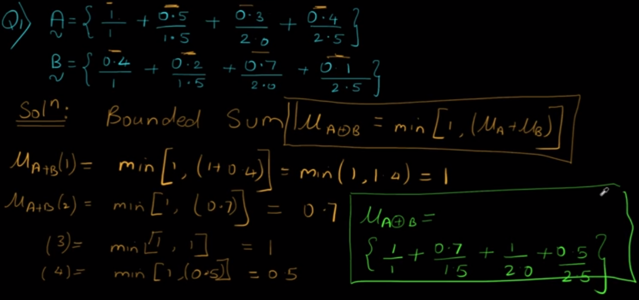

Slide 14
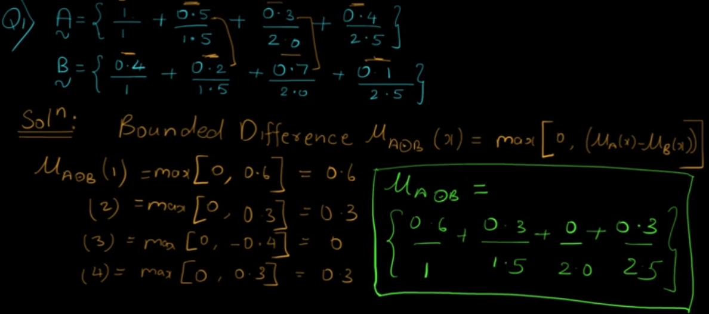

Slide 15
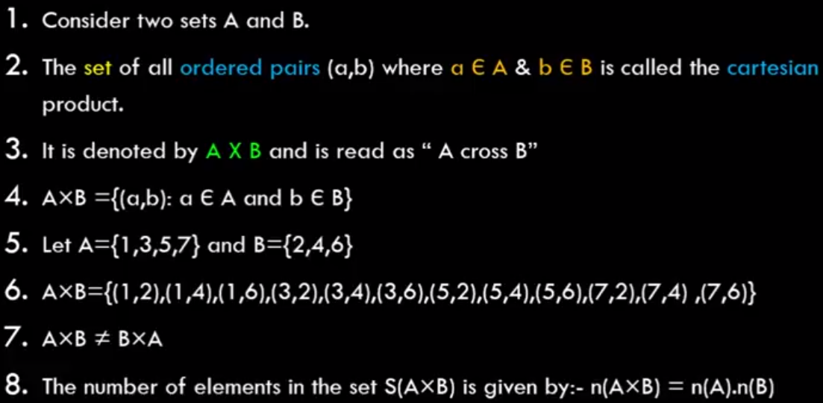
Classical Relations & Cartesian Product of Sets
Cartesian Products

Slide 16
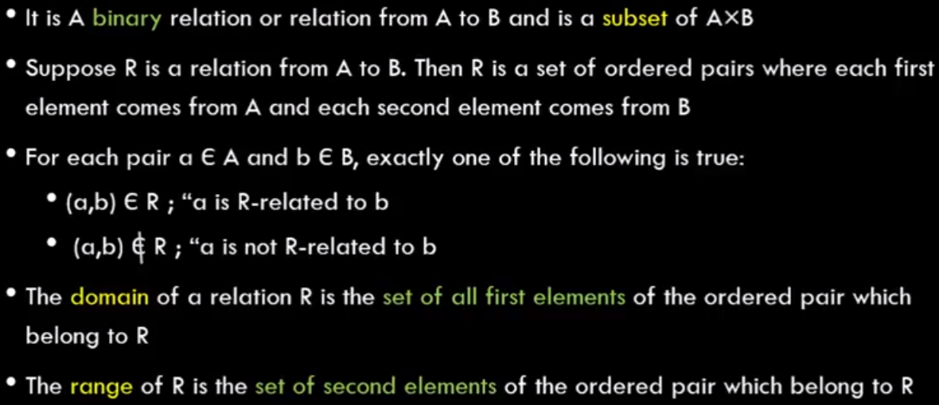
Classical Relations

Slide 17
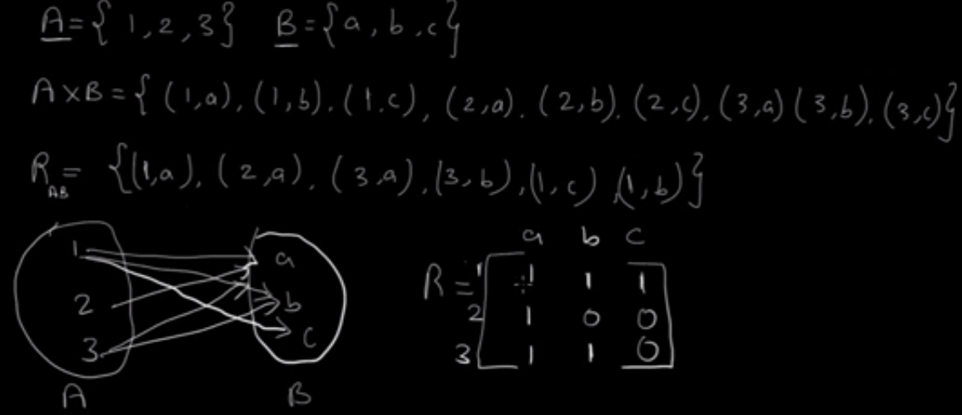

Slide 18
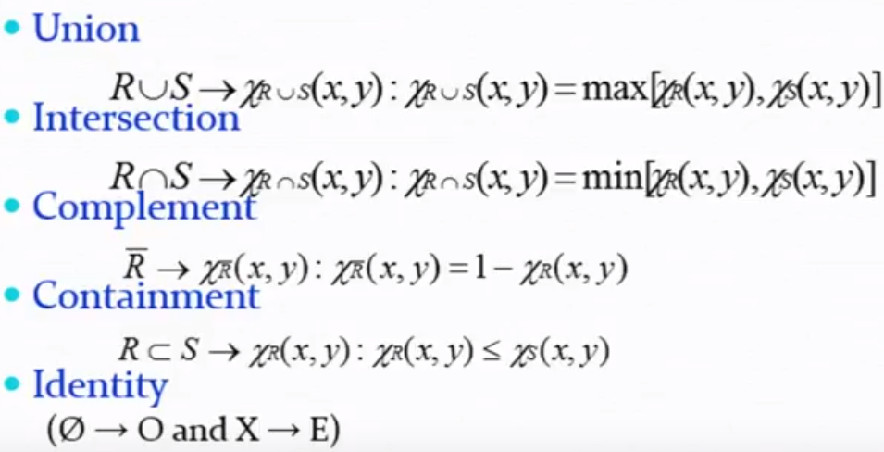
Operations on Classical Relations

Slide 19
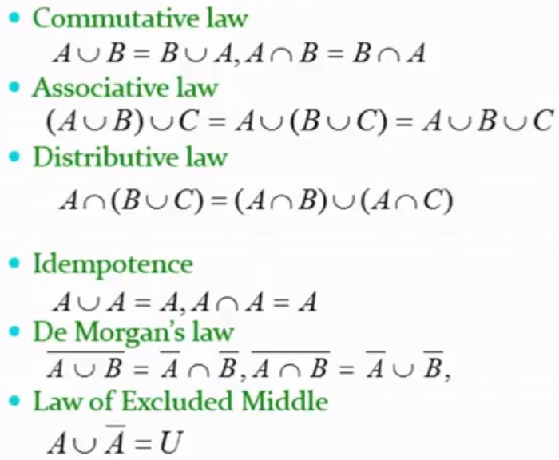
Properties of Classical Relations

Slide 20
Fuzzy Logic
Fuzzy logic teaches computers to make human-like decisions in an uncertain world.
Fuzzy Set Theory
Fuzzy Systems

Slide 21
Crisp
Lotfie A. Zadeh
(1965)
Yes
Is water colourless?
No
Fuzzy
Cardinality
Universal Set
Venn Diagram
Null Set
φ Set
Singleton Set
Set Operations
Is Mohan honest?
Extremely
Very honest
Honest at times
Extremely dishonest

Slide 22
Fuzzy Set
A set containing elements that have varying degrees of membership on that set.
Crisp Set
A set containing elements that have a full membership or complete membership on that set.

Slide 23

Fuzzy means “indefinite”.
Fuzzy sets are those sets in which the containing elements have varying degrees of memberships on those sets..
For uncertainty, a range is set to describe the situation.
10 – 30 → young
30 – 55 → middle age
Above 50 → old age
A crisp set is a set containing elements that have a full membership on that set.

Slide 24
Crisp Set
Universe of Discourse or Universal Set
Set
Venn Diagram
Membership
Cardinality
Family of sets
Null Set /Empty Set
Singleton Set
Subset
Superset
Power Set
Operations on Crisp Set
Union
Intersection
Complementation
Difference

Slide 25
Classical Approach
Boolean Logic
Membership func.
μ_{A} (x) = 1, iif x ε A
= 0, iif x ε A
Set → Collection of well-defined objects
A = { vowels }
A = { a, e, i, o, u }
X = { a, b, …, z
b ε A
ε A
Is A honest?
a ε A
o ε A
True
(1)
False
(0)
Fuzzy Logic
FUZZY THEORY
Developed by Lofti A. Zadeh
(1965) ➔ FUZZY
Is A honest?
Very honest
Honest
Honest (sometimes)
dishonest
(1)
μ_{A} (x) ε [0, 1]
Unsolved
Do not have proper boundaries
(0.8)
1976
(0.5)
(0)
Japan built a subway built on FUZZY THEORY
Grade
(membership value)

Slide 26
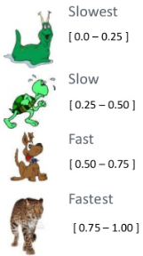
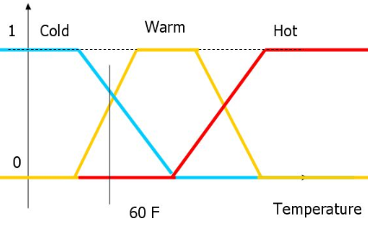
In Artificial Inteligence, the ultimate question is:
MACHINES THINK LIKE HUMAN
Based on ONLY measurements
To solve in FUZZY LOGIC, we have to use “Perception-based Theory”.
Application Areas
Rice Cooker
Automatic Car
Image Processing
Car 1
V. near
Near
Far
V. Far
Car 2
0.9
0.7
0.4
0

Slide 27
Fuzzy Match Use Cases
Here’s a list of couple of use cases where fuzzy match can be used:
To match customers for tracking all purchases of a customer to identifying the buying behavior
To match customer addresses for segmenting customers based on location
To find approximate matches for a search key
To match file paths
For spell-checking
To detect plagiarism (text re-use)
To match DNA sequences
For spam filtering

Slide 28
pip install fuzzywuzzy
pip install python-levenshtein

